Slide 1

Online Book Store Website
This project aims to develop a comprehensive online platform for buying books. This website aims to offer a user-friendly interface, a diverse selection of books, secure payment options, and convenient delivery services.
BY
AVANI KUSHWAHA, ARJUN PANDIT
Session : 2024 – 2025 ( III Semester )

Slide 2


Literature Review
The literature review delves into existing online bookstores, analyzing their features, strengths, and weaknesses. It examines various technologies used in e-commerce, including user interface design, payment gateways, and inventory management systems.
1
User Experience
2
Security and Privacy
3
Business Models
Analysis of different business models employed by online bookstores, such as subscription services, affiliate marketing, and direct sales.
Research on user interface design principles and best practices for online shopping platforms.
Exploration of security measures and data protection protocols used in e-commerce websites.

Slide 3

Objective of the Project
The primary objective of this project is to develop a functional and user-friendly online bookstore website. This platform aims to provide a seamless and engaging experience for users, offering a wide selection of books, secure payment options, and efficient delivery services.
Enhanced User Experience
Expanded Book Selection
Reliable Payment Processing
The website will be designed with an intuitive user interface that allows users to easily browse, search, and purchase books.
The platform will feature a comprehensive collection of books across various genres, catering to diverse reading interests.
The website will integrate secure payment gateways to ensure safe and reliable transactions for users.

Slide 4
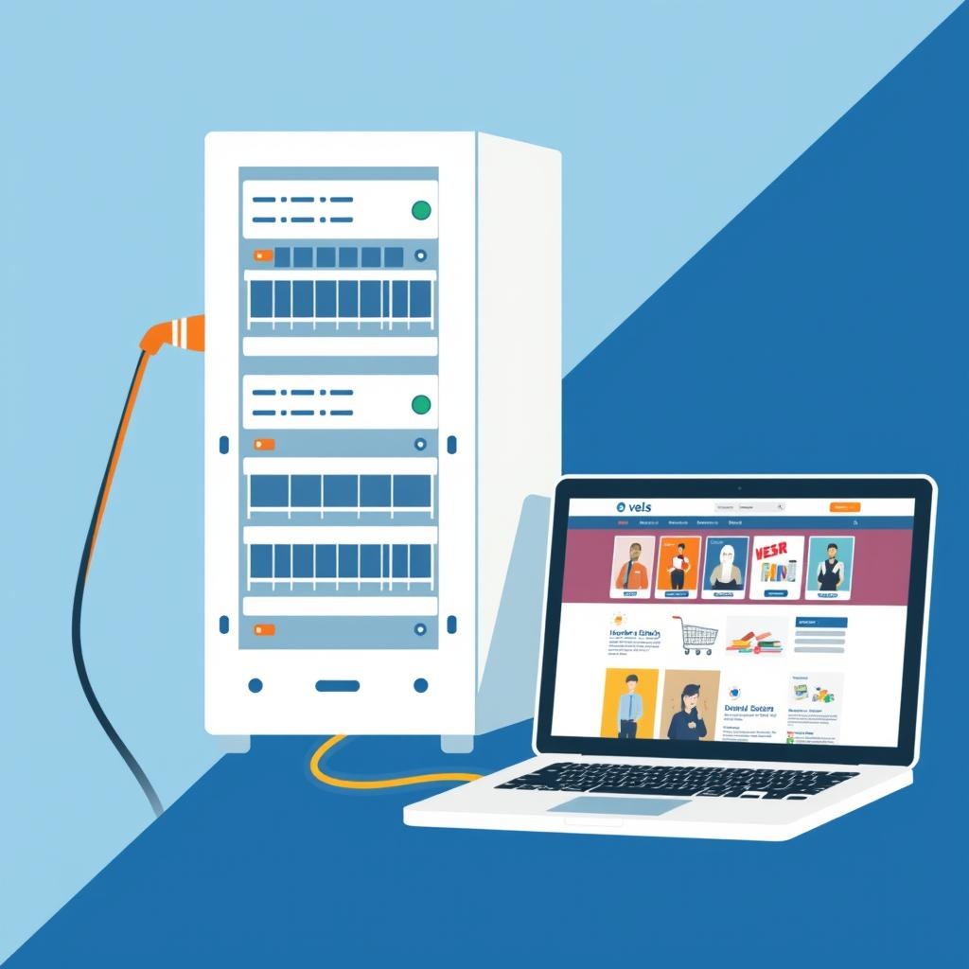
Technology Requirements
The project utilizes a combination of hardware and software technologies to ensure its functionality and scalability. This includes a robust development environment, a reliable server infrastructure, and user-friendly client applications.
Hardware Requirements
Software Requirements
A development environment capable of running web development tools and software. A server capable of hosting the website and handling user traffic. Client devices compatible with the website, such as desktop computers, laptops, smartphones, and tablets.
Web development languages like HTML, CSS, and a backend language like PHP, MySQL Tools like Visual Studio Code for code editing. A database system for storing and managing data, such as MySQL or PostgreSQL.

Slide 5
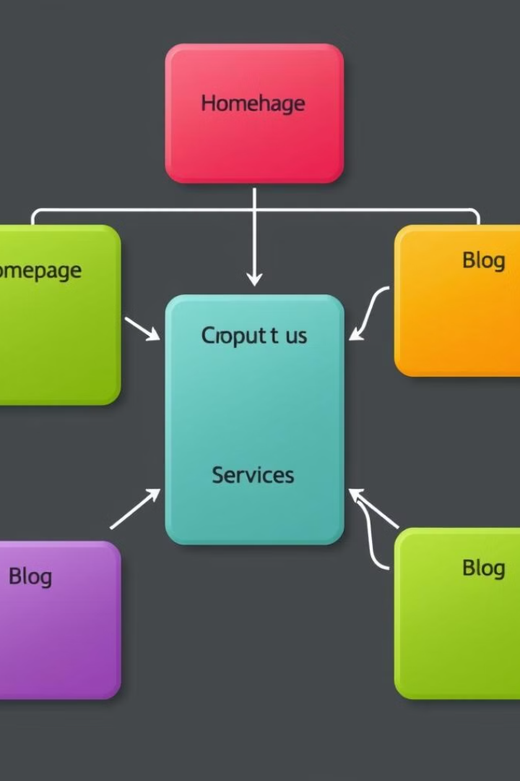




Modules
The website is structured into modular components, each responsible for specific functionalities. This approach allows for efficient development, maintenance, and scalability.
User Interface
The user interface module handles user interactions, navigation, and visual presentation of content.
Database Management
The database module manages the storage, retrieval, and manipulation of website data, including book information, user accounts, and order details.
Payment Processing
The payment processing module handles secure online transactions, integrating with payment gateways to ensure safe and reliable transactions.
Order Fulfillment
The order fulfillment module manages the processing, packing, and shipping of orders, ensuring timely and accurate delivery to customers.

Slide 6
Workflow
The project follows a structured workflow to ensure efficient development and delivery of the website. This process involves distinct phases, each with specific tasks and responsibilities.
1
2
3
4
Planning and Design
Development and Implementation
Testing and Quality Assurance
Deployment and Maintenance
Defining project scope, user requirements, website architecture, and visual design.
Coding the website using chosen technologies, creating modules, and integrating database, payment gateways, and other functionalities.
Rigorous testing of the website to ensure functionality, security, and user experience.
Launching the website on a live server and providing ongoing maintenance, updates, and support.

Slide 7
Reports
The project will generate various reports to monitor website performance, user behavior, and business operations. These reports will provide insights into key metrics and areas for improvement.
Report Description
Tracks user visits, page views, search queries, and other user interactions.
User Activity Report
Analyzes sales revenue, conversion rates, and other key metrics related to book sales.
Sales Performance Report
Tracks book inventory levels, order fulfillment rates, and stock availability.
Inventory Management Report

Slide 8




References
The project draws upon various sources of information, including academic journals, industry reports, and online resources. These references provide insights into best practices, emerging technologies, and industry trends.
Academic Journals
Articles on e-commerce, website development, and user experience design.
Industry Reports
Market research and analysis on the online bookstore industry.
Technical Documentation
Documentation for specific technologies used in the project, such as programming languages, frameworks, and databases.

